Slide 1
Machine Learning & Deep Learning
Week-11
Instructor: Engr. Najam Aziz

Slide 2
Time Series Analysis
Notes:
Another model is Hidden Markhov model

Slide 3
Time Series Analysis
Time has always been a crucial factor when we record or collect data. And in time series analysis, time is a vital variable of the data. Time series analysis helps us to study the progress over a period of time.
Time independent - Data dependent variable
One thing to remember is that the time series models incorporate the fact that time flows in one direction.
Events closed together in time often have a stronger connection than more distant findings.
Purpose:
To understand, interpret, access chronological (following the order in which they occurred) changes in the value of a variable, in the past, so that reliable prediction can be made about the future value.
On the basis of the past, predict/forecast the future.

Slide 4
A Quantitative Forecasting Method to Predict Future Values
Numerical Data Obtained at Regular Time Intervals
Projections Based on Past and Present Observations
Example:
Year: 1994 1995 1996 1997 1998
Sales: 75.3 74.2 78.5 79.7 80.2

Slide 5
Examples of Time Series
Average monthly temperature
Annual profit for a company
Daily petrol price at the pump
Hourly electricity consumption at the home
Quarterly House Sales

Slide 6
Uses of time series analysis
Time series analysis is usually used in industries where there are fluctuations over time or are affected by time. Industries like retail, E-commerce, and finance often use time series analysis because currency and sales are always changing.
Stock market analysis is an outstanding example of time series analysis, especially with automated trading algorithms. Furthermore, time series analysis is also used to forecast weather changes, helping meteorologists predict the weather from the last few days of the weather report.
For example, Dell analyzed five years of festive season sales data to identify the right strategy for this festive season.

Slide 7
Applications of time series analysis
Everywhere when data are observed in a time ordered fashion. For example:
Economics: daily stock market quotations or monthly unemployment rates.
Social sciences: population series, such as birth rates or school enrollments.
Epidemiology: the number of influenza cases observed over some time period.
Medicine: blood pressure measurements traced over time for evaluating drugs.
Global warming

Slide 8
Time Series Component
Time series data has four aspect of behavior.
Trend: is the overall long term direction of the series - long term. Increasing or decreasing
Seasonality: occurs when there is repeated behavior in the data which occur at regular intervals. Related to seasonal nature or human behavior, examples: Eid, Basant etc
Cycles: occurs when a series follow up-and-down pattern that is not seasonal. Can be of varying length. Which makes them more difficult to detect than seasonality.- examples: Business cycles
Random / Irregular Variations: In all data, there is random variation. Short Duration and Non-repeating Examples: Earthquake, sounomi, flood, corona, natural calamities etc

Slide 9
Modeling Time Series
There are many ways to model a time series in order to make predictions.
Moving Averages
Exponential Moving Averages
Linear Regression
Exponential Smoothing
ARIMA
RNN
LSTM

Slide 10
Moving Averages
Used for Smoothing
Series of Arithmetic Means Over Time
Result Dependent Upon Choice of L, Length of Period for Computing Means
Example: 3-year Moving Average
First Average: MA (3) = (Y1 + Y2 + Y3) / 3
Second Average: MA (3) = (Y2 + Y3 + Y4) / 3

Slide 11
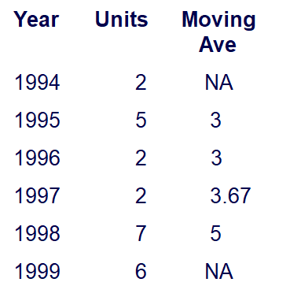

Moving Average Example
John is a building contractor with a record of a total of 24 single family homes constructed over a 6 year period. Provide John with a Moving Average Graph.

Slide 12
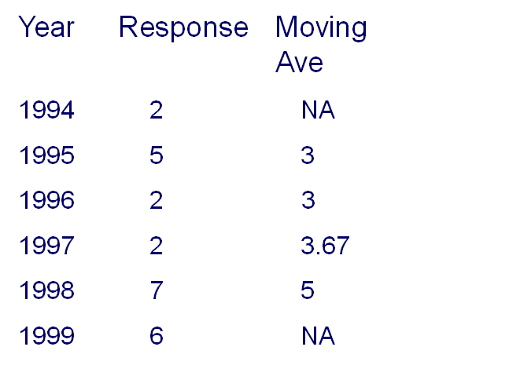
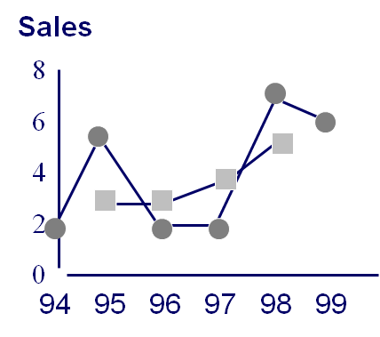
Time (Year)

Slide 13
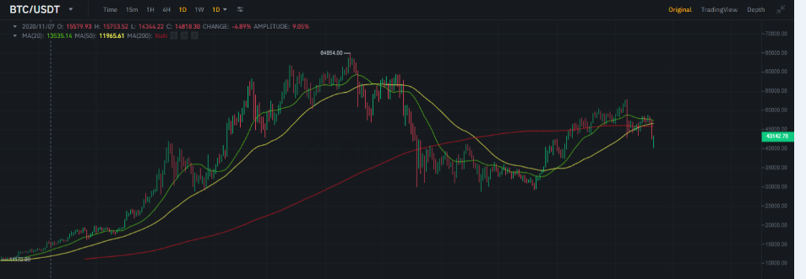
Moving Averages BTC Chart

Slide 14
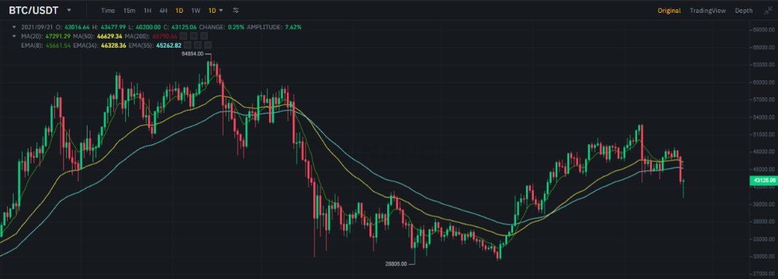
Exponential Moving Averages - BTC chart

Slide 15
Key Takeaways
A time series is a data set that tracks a sample over time.
In particular, a time series allows one to see what factors influence certain variables from period to period.
Time series analysis can be useful to see how a given asset, security, or economic variable changes over time.
Forecasting methods using time series are used in both fundamental and technical analysis.
Although cross-sectional data is seen as the opposite of time series, the two are often used together in practice.

Slide 16
Questions!

Slide 17
Extra info
Prediction vs Forecast
The only difference between forecasting and prediction is the explicit addition of temporal dimension in forecasting. Forecast is a time-based prediction i.e. it is more appropriate while dealing with time series data.
Classification vs Prediction
Classification is the process of identifying the category or class label of the new observation to which it belongs. Predication is the process of identifying the missing or unavailable numerical data for a new observation.
Sequential Data:
The order of the data matters, but the time stamp is irrelevant or it doesn’t matter. (Example: DNA sequence. As you see the concept of time is irrelevant, so the order is not temporal.)

